Slide 1
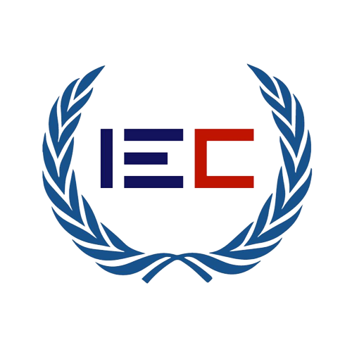
Portfolio Project
Blockchain-Based Land Registry System
Student Name : Muhammad Ahmed Course : Blockchain Teacher : Sir Umer Aqeel Cohort : 3

Slide 2
INTRODUCTION
Land registration is any of various systems by which matters concerning ownership, possession, or other rights in land are formally recorded. Usually with a government agency or department) to provide evidence of title, facilitate transactions, and prevent unlawful disposal.

Slide 3
PROBLEM
In today's scenario, many news related to fake land titles, fraud land registry, delay in ownership transfer, the involvement of government officers in fraudulent activities is frequently being heard.
However, this represent that the existing land registry system is not efficient to provide security and timely settlement of transactions between the seller and buyer.

Slide 4
SOLUTION
Decentralized System
Prevent Sales Fraud Through Smart Contract
Verification
Removal of Property Dealer
Prevention of Selling Fake Land Through Verification
No-Trust
Using Smart Contract In Block Chain For Registration

Slide 5
METHODOLOGY
The Owner of Solidity Smart Contract will be LandInspector,
Seller will register him/her self, landInspector verified that seller details, Land Inspector will verify or Reject the Details added by seller. After that seller will be able to upload the land details which they wants to sell.
Landinspector will again verified that land uploaded by seller to check either the land details are correct or not, verified or not. If land details is not verified, false & fake landInspector will not verified that land.

Slide 6
METHODOLOGY
Buyer will register him /her self, LandInspector verified that buyer details, Land Inspector will verify or Reject the Details added by buyer. Buyer Can Only Purchase the Land if and only if Land And the Buyer both are verified.
Buyer will Enter the land info and amount of land he wants to purchase if the land price entered by the buyer is the same landprice which Fixed by the Seller as the buyer Purchase the land the ownership of Land will be transfer to Buyer and Land Price will be transfered to seller.

Slide 7
CONCLUSION
Both Seller and Buyer are independent of Trust to each other Land Inspector will provide a key role in the Land Registration System Based on Solidity Smart Contract so no one can add fake Details.
This Project on Smart Contract will not only prevent Sales Fraud but also Make the Land Registration System Easy and Fast.

Slide 8
THANK YOU

